Slide 1

AutoCAD® Certified Exam Preparation
Rick Feineis, CTT
AutoCAD Certified Professional
Autodesk Revit Certified Instructor
Autodesk Authorized Training Center Owner

Slide 2
Class Summary
Certification is an important step in differentiating yourself from other AutoCAD users.
This class will cover critical objectives on features and workflow that you need to know to become certified in AutoCAD.

Slide 3
Learning Objectives
At the end of this class, you will be able to:
Identify the differences between the AutoCAD® Certified Associate and AutoCAD® Certified Professional exams
Identify the major technical knowledge and skill objectives for the AutoCAD Certified Associate and Professional Examinations
Develop study and preparation strategies for the AutoCAD Certified Associate and Professional Examinations
Develop test-taking and time-saving strategies

Slide 4

Who Is This Training Session For?
People interested in preparing for and taking the AutoCAD Certified Associate and Professional Examinations at a testing center or at Autodesk University

Slide 5
Course Agenda
What are the Certification Examinations?
Who should attempt Certification?
Advantages of Certification
Determining Knowledge and Skills Deficiencies
Assessment Practice Exams
Exam Overview
Exam Objectives
Top Ways to Pass the Certification Examinations
Time Management and Test taking Strategies

Slide 6
What Are The Certification Examinations?

Slide 7
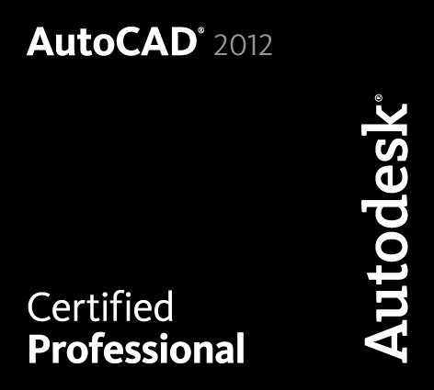
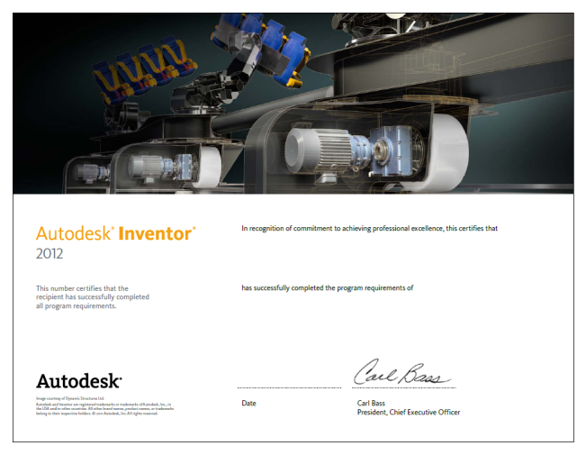
What Are The AutoCAD Certification Examinations?
Validates Knowledge and Skills
  Gain an industry recognized credential that proves your skill level
Receive Industry Recognition
  Use the Autodesk Certified Logo
  Display your Autodesk Certified certificate
  List your name in the Autodesk Certified Professionals database

Slide 8
Who Should Attempt AutoCAD Certification?
Anyone wishing to validate knowledge and skills
    In order to receive a promotion by accelerating your professional development
    In order to differentiate yourself when trying to secure employment
Any employer wishing to validate knowledge and skills
    Use to differentiate employees during the interview process
    Enhance your organization’s credibility within your field

Slide 9

Why Become Certified in AutoCAD?
41% of employers pay 100% of technical certification*
12% of employers share the cost with their employees*
47% of the time the cost is carried by AutoCAD users like yourself
* Data is provided by Autodesk Certification and Testing

Slide 10

Why Become Certified in AutoCAD?
30% of certified technical experts receive a job promotion within 1st year of earning certification*
60% of those promoted believed that their certification played a vital role*
On average, certified experts receive a 15% salary increase*
* Data is provided by Autodesk Certification and Testing

Slide 11
Differences Between the Associate and Professional Examinations

Slide 12
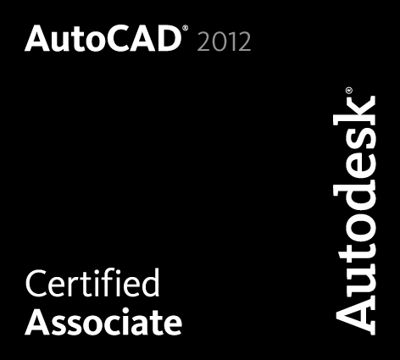
What Are The Different Levels Of Certification?
Associate is certification of Knowledge of feature and function
Professional is certification of skills ability – Performance

Slide 13
AutoCAD Certified Associate
Certified Associate Examination
Exam Interface and Question Types
Test Taking Strategies
Top Ways to Pass the Associate Examination

Slide 14
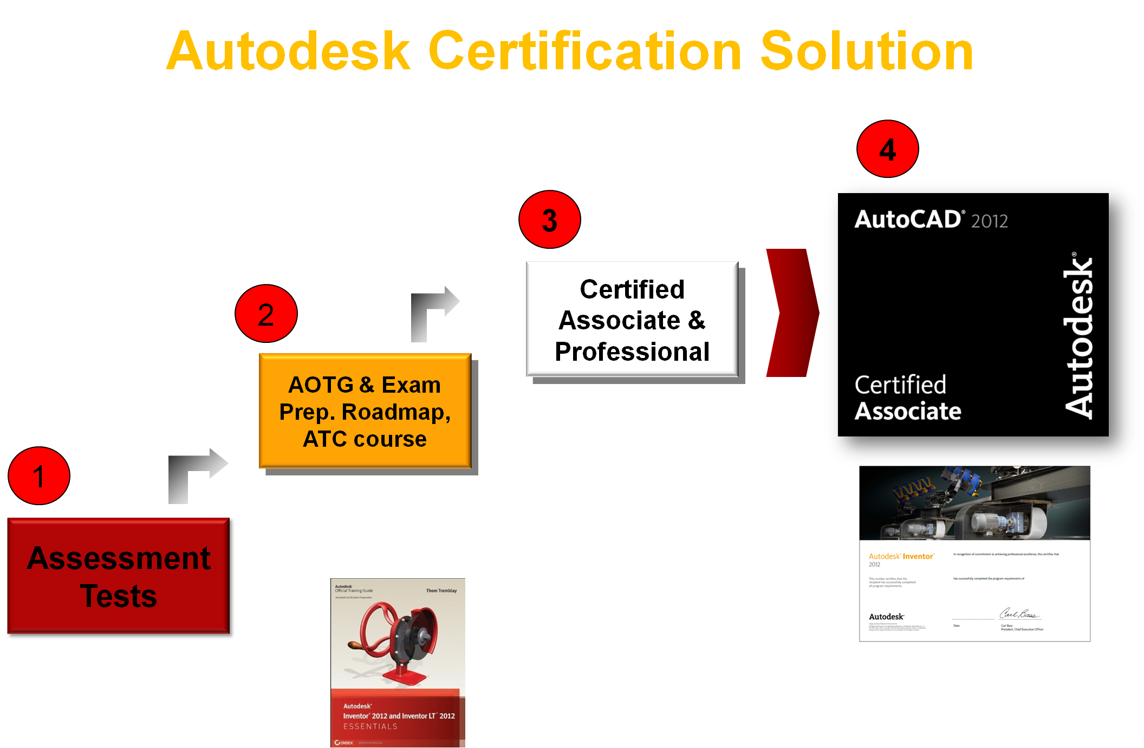
AutoCAD Certified Associate

Slide 15
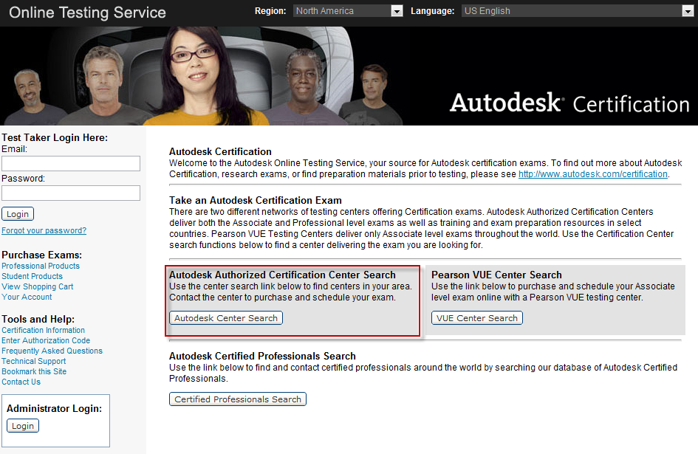
Where Are The Available Examinations?

Slide 16
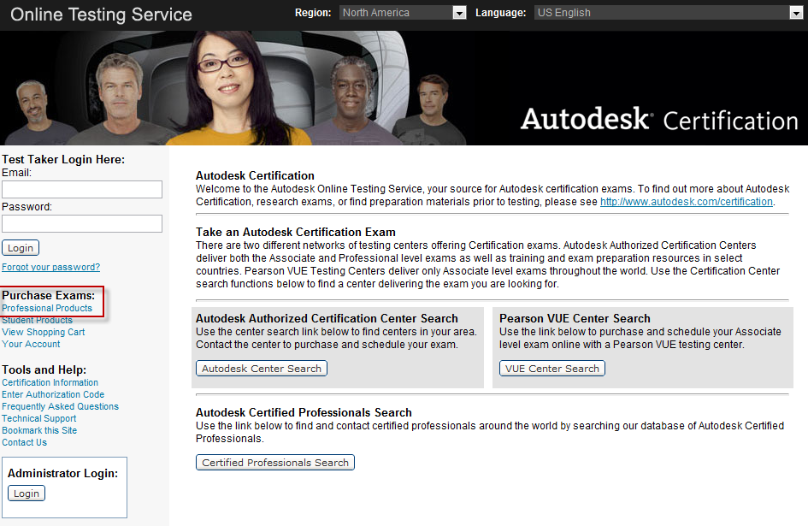
What Are The Available Examinations?

Slide 17
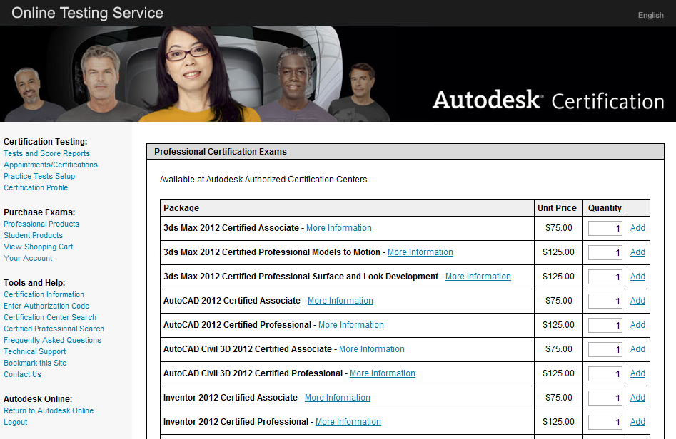
What Are The Available Examinations?

Slide 18
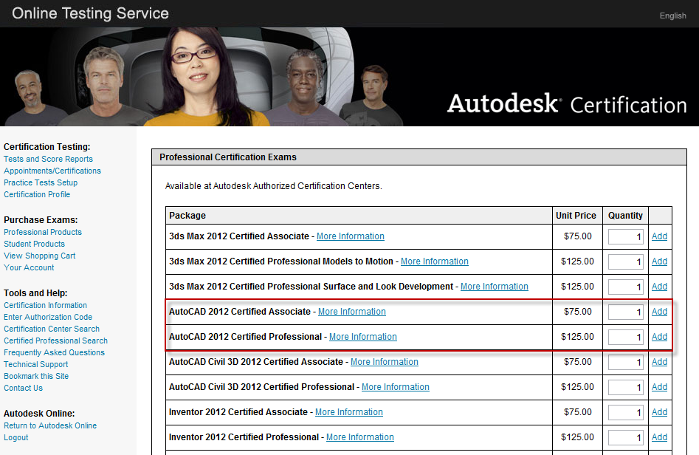
What Are The Available Examinations?

Slide 19
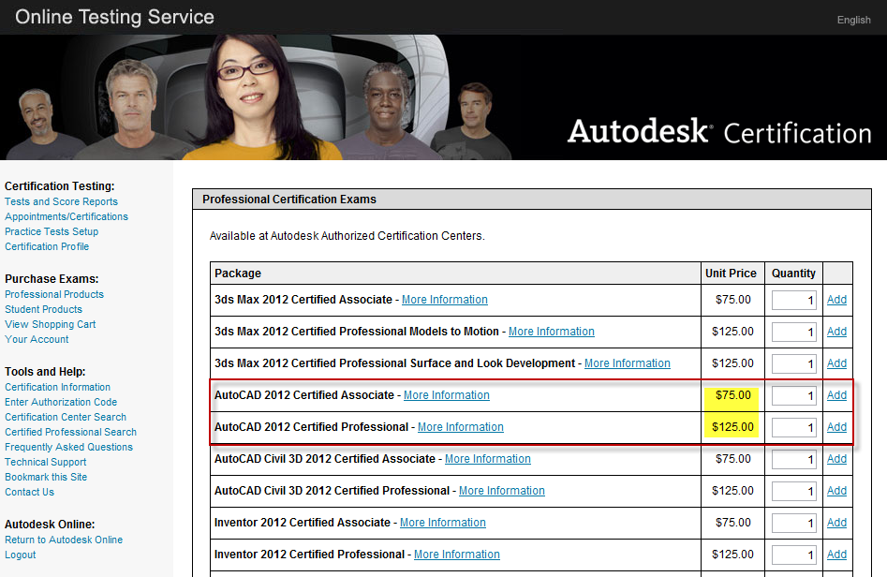
What Are The Available Examinations?

Slide 20
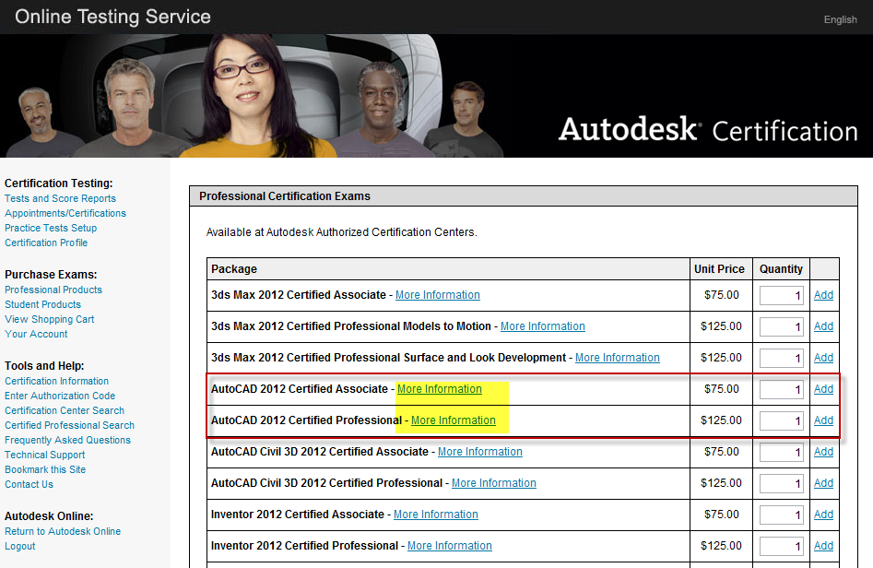
What Are The Available Examinations?

Slide 21
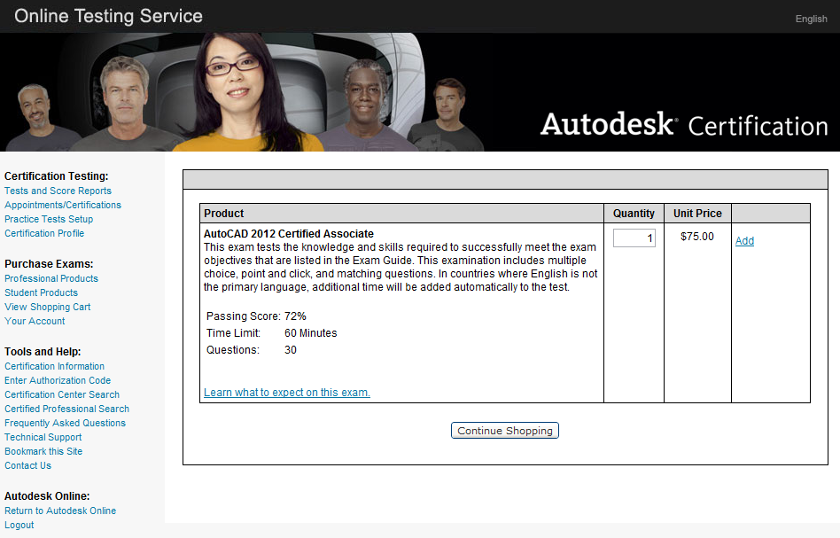
What Are The Available Examinations?

Slide 22
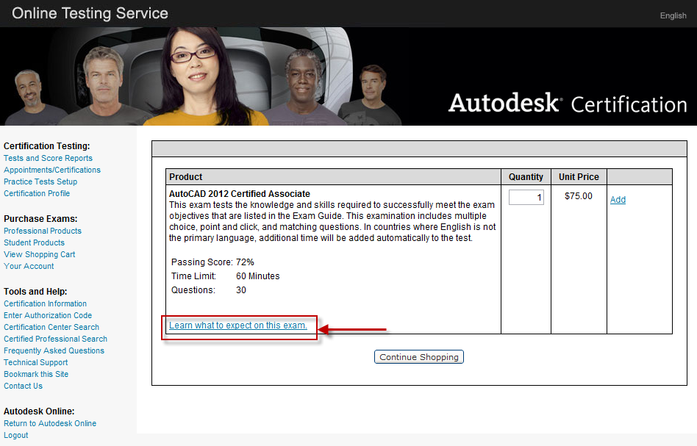
What Are The Available Examinations?

Slide 23
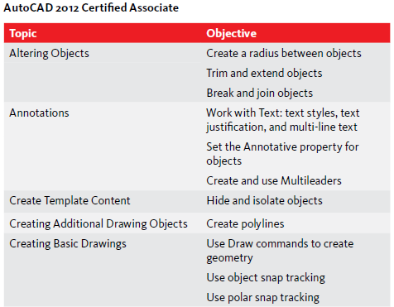
What Topics Are Covered On The Associate Examination?

Slide 24
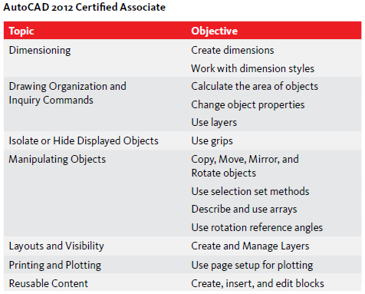
What Topics Are Covered On The Associate Examination?

Slide 25
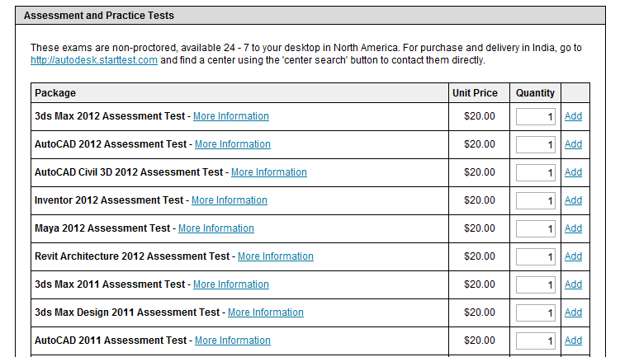
What About The Assessment Tests?

Slide 26
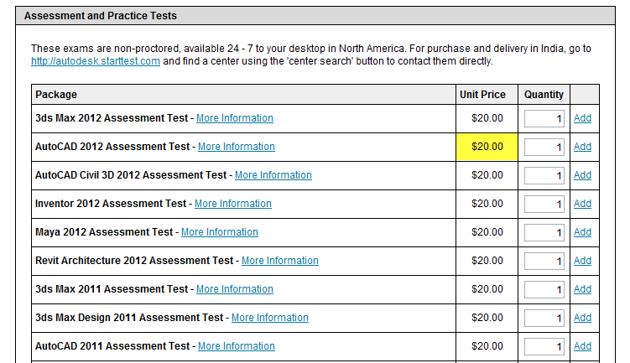
What About The Assessment Tests?

Slide 27
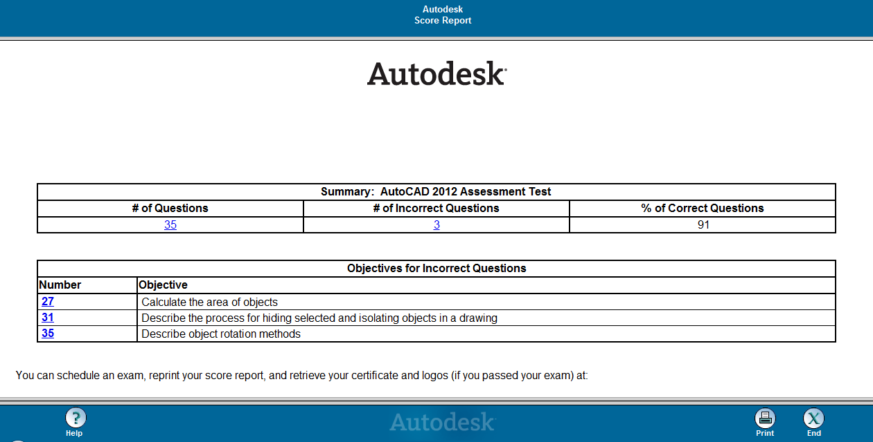
What About The Assessment Tests?

Slide 28
Associate Examination Interface – Question Types

Slide 29
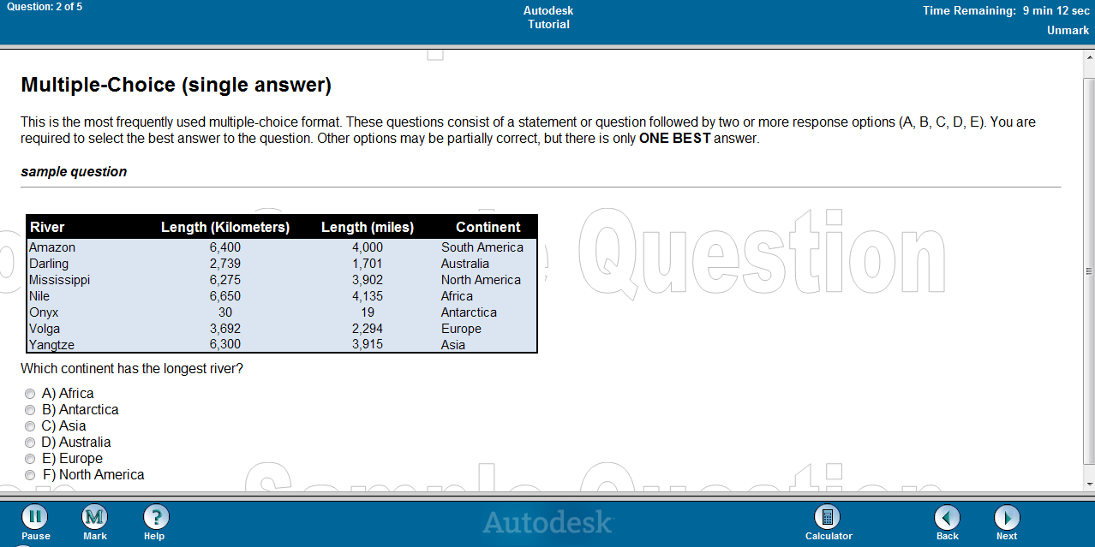
Question Types – Multiple Choice (Single Answer)

Slide 30
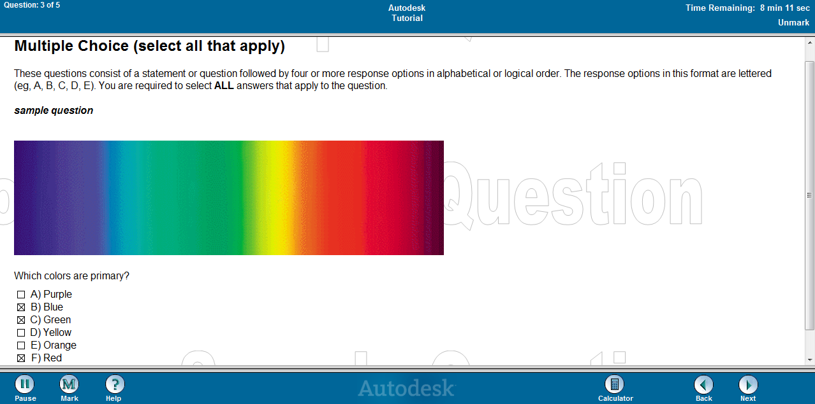
Question Types – Multiple Choice (Select All That Apply)

Slide 31
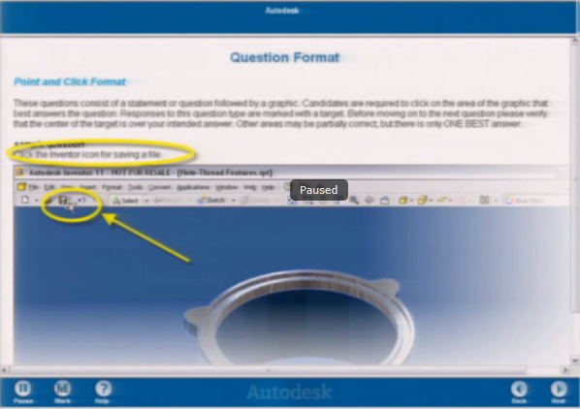
Question Types – Point and Click

Slide 32
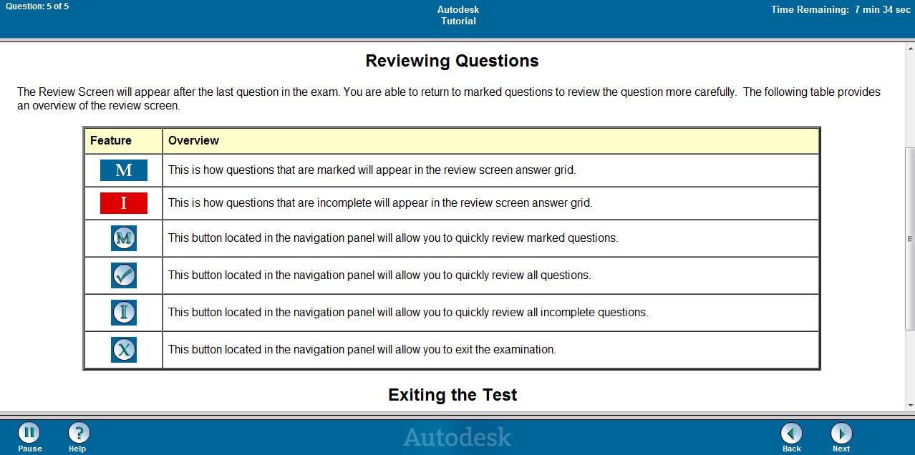
Question Types – Multiple Choice (Select All That Apply)

Slide 33
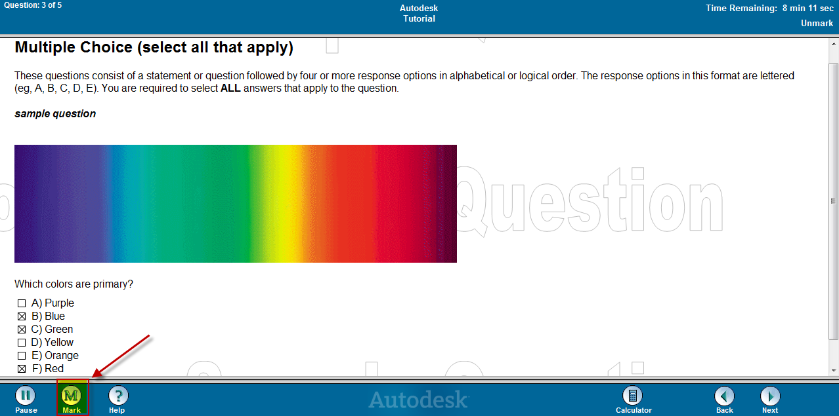
Question Types – Multiple Choice (Select All That Apply)

Slide 34
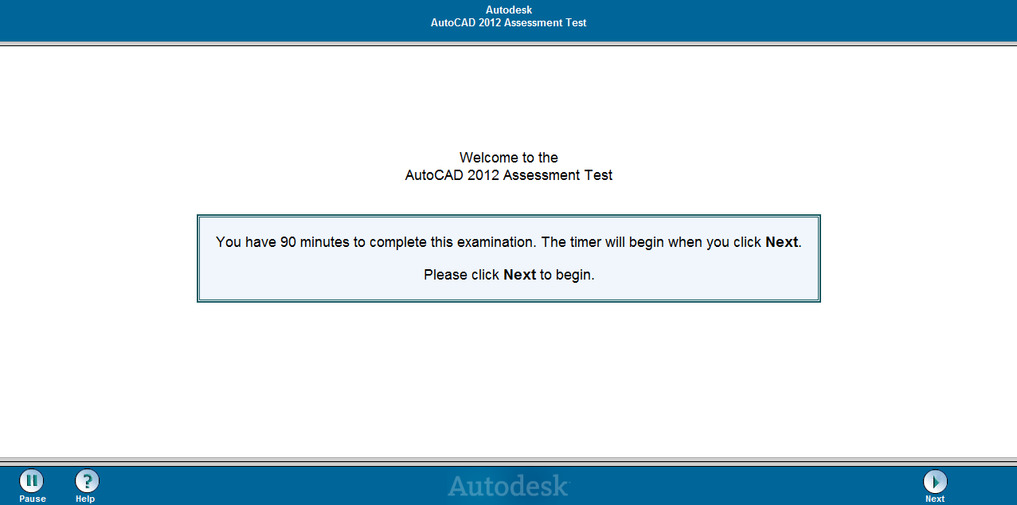
Question Types – Multiple Choice (Select All That Apply)

Slide 35
Examination Strategy

Slide 36
Examination Strategy
DO NOT RUSH – There is no bonus prize for the fastest time!
Answer questions that you are 100% confident of
Mark questions that you can answer, but are not 100% confident of
Skip all questions that you do not know the answer to
USE 100% OF YOUR TIME AVAILABLE
USE THE REVIEW TOOL TO YOUR ADVANTAGE

Slide 37
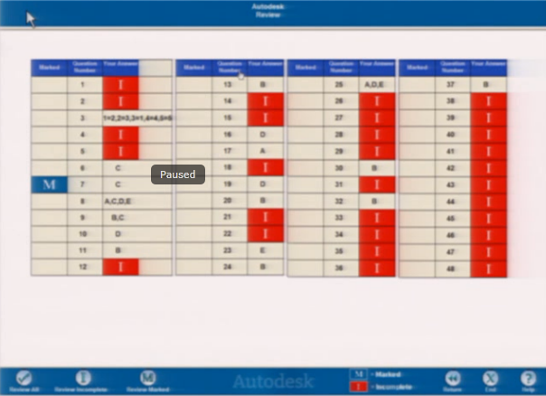
Examination Strategy – Review Phase

Slide 38
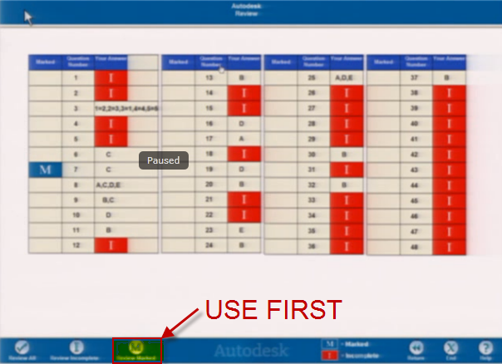
Examination Strategy – Review Phase

Slide 39
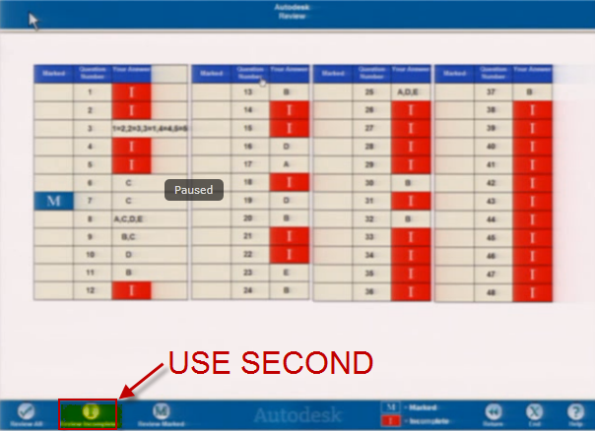
Examination Strategy – Review Phase

Slide 40
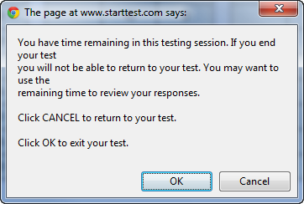
Finishing The Examination

Slide 41
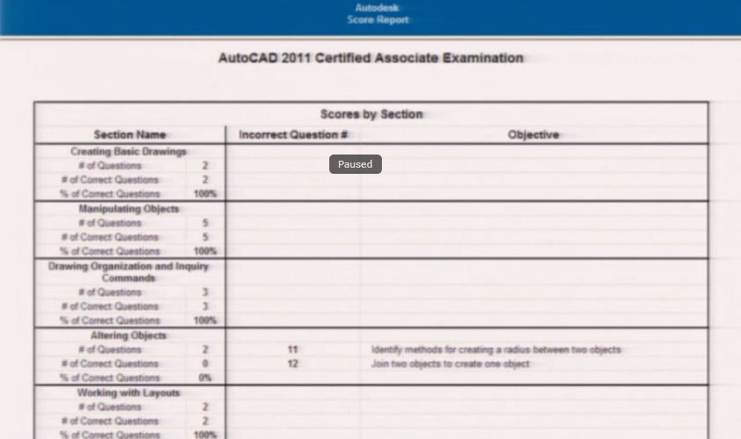
Successful Completion – Score Report

Slide 42
Successful Completion – Logo and Certificate

Slide 43
Examination Strategy Review

Slide 44
Examination Strategy
Take the Assessment Examination first in order to know what you need to study for.
Use the Assessment results as your study guide
Read the Question Completely! – Read it TWICE
  There is a whole science behind the creation of examination questions and there are distracters that are placed in the examination to through you off. Be very careful of the wording and read the question twice.
Mark Questions that you think you know so you can focus on them first
Skip Questions that you do not know – They will be flagged as Incomplete and will allow you to separate them from the ones that you mark.

Slide 45
Review for Passing the Certified Associate Examination

Slide 46
Top Ways to Pass the Certification Associate Exams
Read questions for inconsistencies (i.e. Object snap tracking is orthogonal which means you can align to 0, 30, 45 and 60 degrees).
Object snap tracking
Editing Polylines with grips in 2012 – What options are available
Know how to use the array path in 2012
Know what the Join command does
Know all of the odd, hardly used commands
How is text justified?

Slide 47
Top Ways to Pass the Certification Associate Exams
Know all the options for layers (transparency, linetypes, Lock Fading, layer naming restrictions, etc.)
What can you fillet? Text, Xlines, Rays?
Know the commands for editing dimensions
Polar tracking – Do you use it or are you stuck on ORTHO?
What are the options within trim and extend?
Know Annotative inside and out…
Ordinate dimensions? Only for Mechanical designers, probably not on the test.
What can the area option measure?

Slide 48
Top Ways to Pass the Certification Associate Exams
Know obscure selection commands (fence, crossing polygon)
Know all of the buttons in each creation command that uses a ribbon (text, hatch)
Know Layouts and Scaling inside and out
Know Plotting Dialog box
Know what happens when blocks are created on Layer 0
Know Grips and how they act in each command
Know how to Rotate Reference and Scale Reference

Slide 49
AutoCAD 2012 Tips for Answering the Questions

Slide 50
Preparing for the Certified Associate Exam

Slide 51
Preparing for the AutoCAD Associate Examination
Take the Assessment Examination
  Determine Your Skill Gaps
Use the Authorized Study Guides
  www/autodesk.com/estore
Schedule custom training from an ATC that is based on your skill gaps
  This can be one on one via the internet for individuals or groups
Take the Associate Examination

Slide 52
AutoCAD Certified Professional
Certified Professional Examination
Question Types
Test Taking Strategies

Slide 53
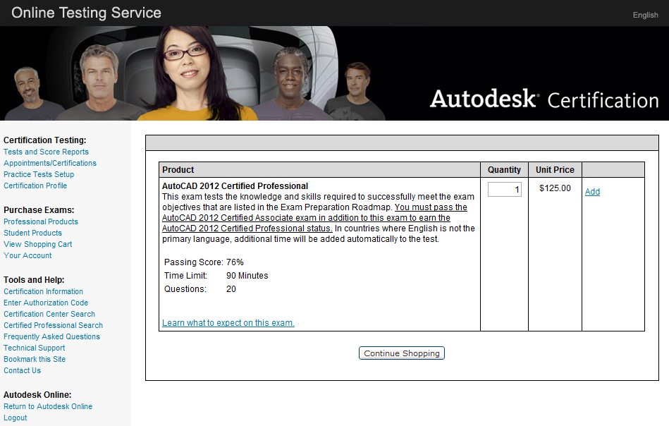
What Are The Available Examinations?

Slide 54
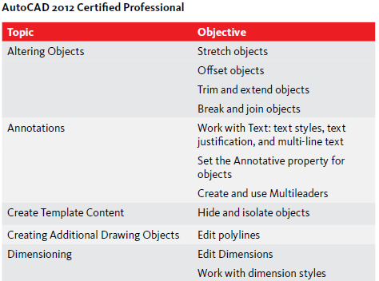
What Topics Are Covered On The Professional Exam?

Slide 55
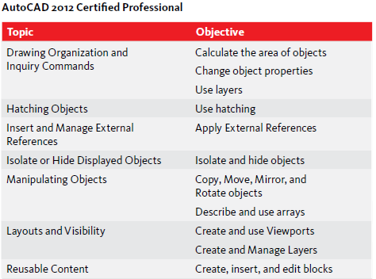
What Topics Are Covered On The Professional Exam?

Slide 56
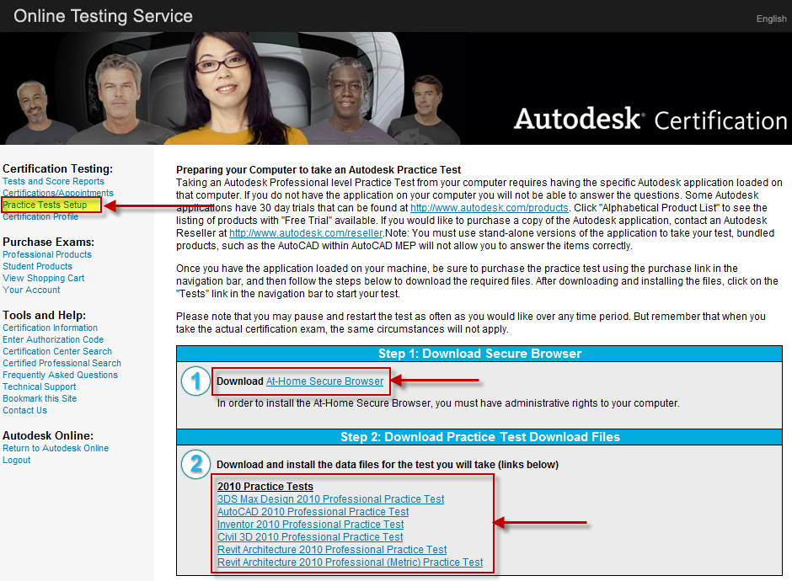
Preparing for the AutoCAD Professional Examination

Slide 57
What About The Assessment Tests?

Slide 58
Professional Examination Interface -
Question Type

Slide 59
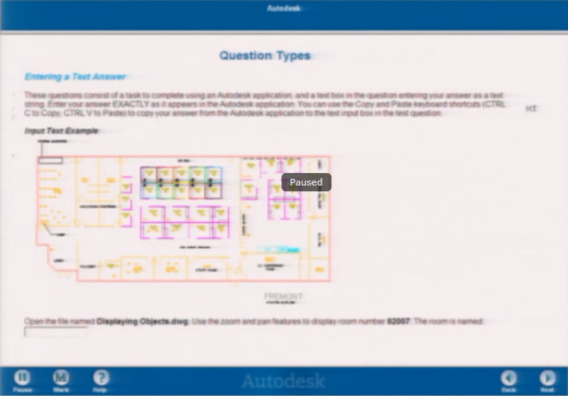
Question Type – Enter Text or Numbers Only

Slide 60
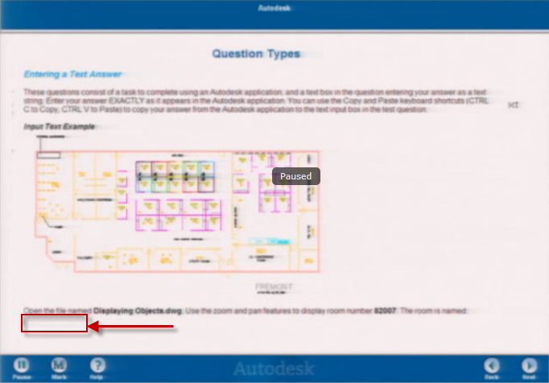
Question Type – Enter Text or Numbers Only

Slide 61
Examination Strategy

Slide 62
Examination Strategy
DO NOT RUSH – There is no bonus prize for the fastest time!
Answer questions that you are 100% confident of
Mark questions that you can answer, but are not 100% confident of
Skip all questions that you do not know the answer to
USE 100% OF YOUR TIME AVAILABLE
USE THE REVIEW TOOL TO YOUR ADVANTAGE

Slide 63
Examination Strategy
Answer MARKED questions first
Answer INCOMPLETE questions last
Highlight answer in AutoCAD text window, right click and select copy
Use Ctrl-V to paste
Follow the directions in the examination to the letter

Slide 64
Review for Passing the Certified Professional Examination

Slide 65
Top Ways to Pass the Certification Professional Exams
Questions will ask you to open a certain drawing – Use ALT TAB to cycle over to AutoCAD and back to the Examination
No multiple choices here! – You have to put an answer into an answer box.
  It is either right or it is wrong.
  The text answers are not case sensitive.
Make sure that you know your AutoCAD inquiry commands so you can gather information quickly to put into the exam’s answer boxes.

Slide 66
Top Ways to Pass the Certification Professional Exams
Use Object Snap Override
Highlight answer, right click and select copy
Use Ctrl-V to paste
Follow the directions to the letter
Know your way around Dim Styles
Know how Associative Dimensions and Text work
Know where the Annotation Visibility and Automatically Add Scale to Annotations commands are located

Slide 67
Top Ways to Pass the Certification Professional Exams
Know your dimension modification commands
Know how to snap to Insertion Points
Accurately select objects when placing baseline and continue dimensions
Know how to manipulate vertex points for polylines
Know all of the options in each command
Know how to manipulate leaders to align them
Know how to use the Properties Palette to manipulate objects geometry

Slide 68
Top Ways to Pass the Certification Professional Exams
Know how to Regen drawings
Know how to Redefine Blocks
Know how to locate the Palettes in the Block Editor
Know how to set an Annotation Scale in MS
Know how to use the updated Array command in 2012 (Rectangular and Polar)
Be careful to select the appropriate points when measuring distances
Know how to Add and Subtract Areas

Slide 69
Top Ways to Pass the Certification Professional Exams
Know all of the options within the Hatch command
Know how to calculate the areas of polylines and hatch patterns
Know how to edit dimensions to place text in different locations
Know how to hide and isolate objects
Know how to Rotate reference and Scale Reference

Slide 70
AutoCAD 2012 Tips for Answering the Questions

Slide 71
Top Ways to Pass the Certification Professional Exams
Use Copy and Paste to transfer the answer from AutoCAD to the Examination
Use the AutoCAD Help Menu if you have to. It is OK to do this, but watch the clock!
Draw only what you need to draw. Don’t waste time. This is a timed examination, so stay focused.
Draw and modify all geometry perfectly. Your answers will come from your being able to very precise.
Draw your geometry using the method asked – Don’t use your own drafting process, use what the examination developers ask for.

Slide 72
Top Ways to Pass the Certification Professional Exams
Know and use your AutoCAD Inquiry commands inside and out (Practice these!)
Use your OSNAP with SNAP turned OFF so you pick correctly
When drawing objects, beware of duplicate and overlapping objects
Learn and use the most effective method to obtain area calculations (Hatch or Boundary)
Double check your work! Many people that come to take these examinations are either nervous or a bit headstrong where they think their strengths are. Rushing through the examination is a certain way to make mistakes and will almost guarantee that you fail.

Slide 73
AutoCAD 2012 Tips for Answering the Questions

Slide 74
Preparing for the Certified Professional Exam

Slide 75
Learning Objectives
At the end of this class, you are now able to:
Identify the differences between the AutoCAD® Certified Associate and AutoCAD® Certified Professional exams
Identify the major technical knowledge and skill objectives for the AutoCAD Certified Associate and Professional Examinations
Develop study and preparation strategies for the AutoCAD Certified Associate and Professional Examinations
Develop test-taking and time-saving strategies

Slide 76

Additional Resources
Certification URL: www.autodesk.com/certification
Autodesk Email: certification@autodesk.com
CAD Training Online: www.CADtrainingOnline.com
Purchase & Register: http://autodesk.starttest.com
ATC training: http://www.autodesk.com/atc

Slide 77
Conclusion
How to get in touch with me:
  RICK.FEINEIS@CADTRAININGONLINE.COM
  ASK QUESTIONS VIA THE AUTODESK UNIVERSITY INTERFACE
Please complete the course evaluation so we can make improvements.
Good luck on your preparation. Do not hesitate to contact me for one on one internet based training to prepare for the examinations.

Slide 78


Autodesk, AutoCAD* [*if/when mentioned in the pertinent material, followed by an alphabetical list of all other trademarks mentioned in the material] are registered trademarks or trademarks of Autodesk, Inc., and/or its subsidiaries and/or affiliates in the USA and/or other countries. All other brand names, product names, or trademarks belong to their respective holders. Autodesk reserves the right to alter product and services offerings, and specifications and pricing at any time without notice, and is not responsible for typographical or graphical errors that may appear in this document. © 2011 Autodesk, Inc. All rights reserved.

